Slide 1
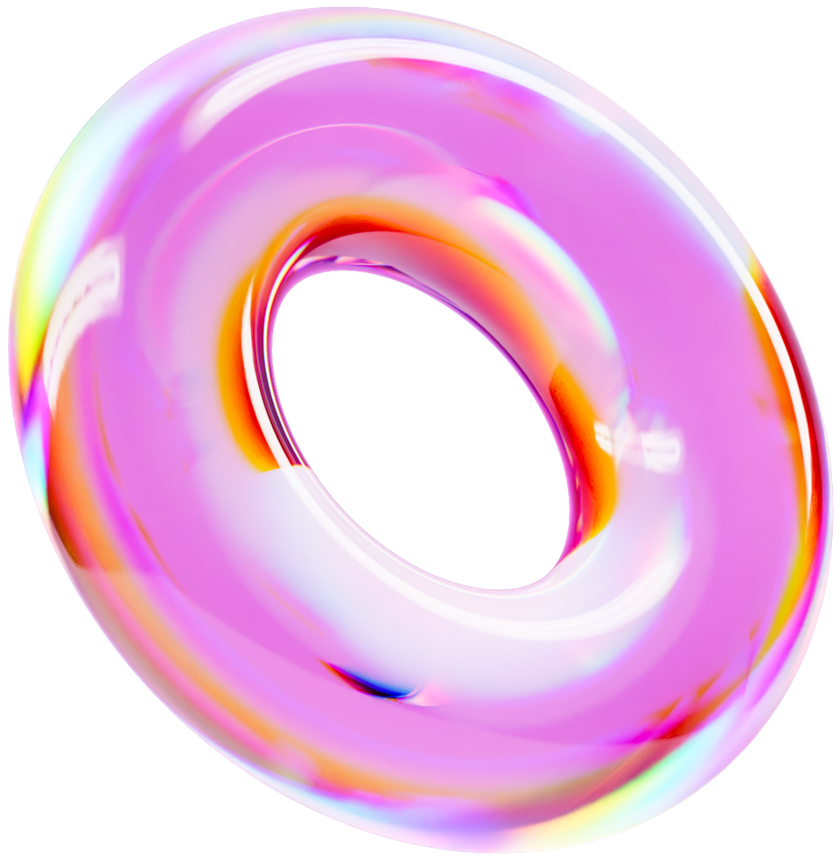



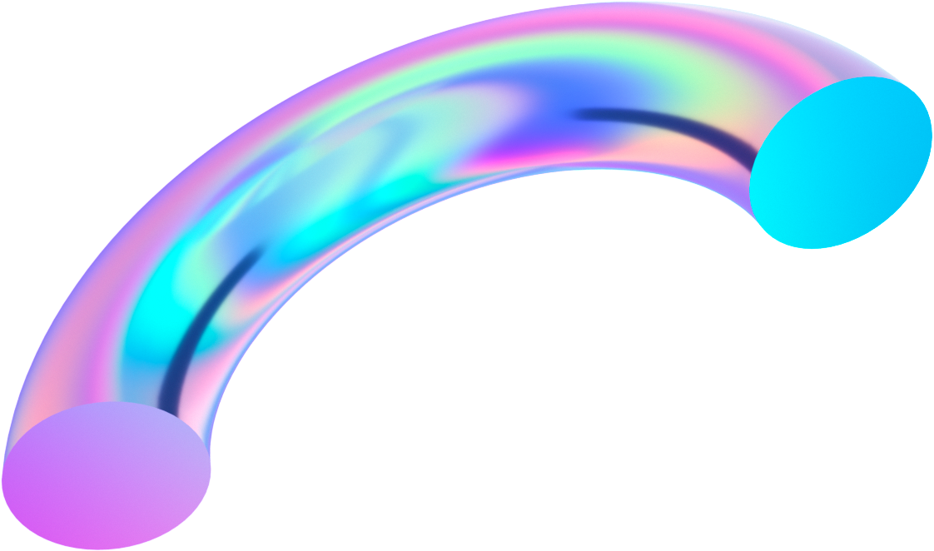
PEGASUS
DEVESH MISHRA
RISHABH
E22CSEU0766
E22CSEU0758

Slide 2
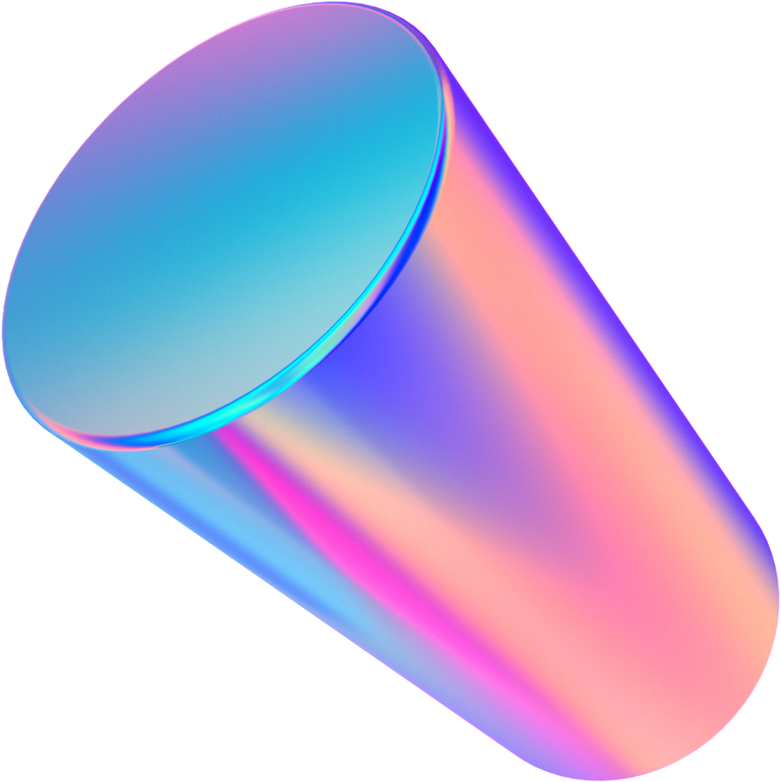
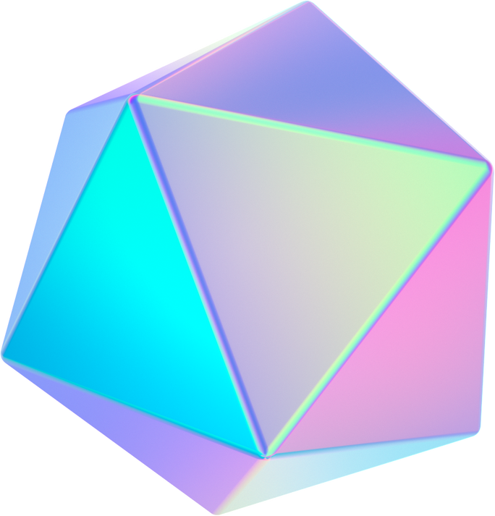
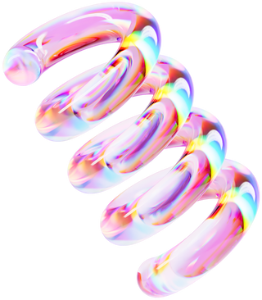
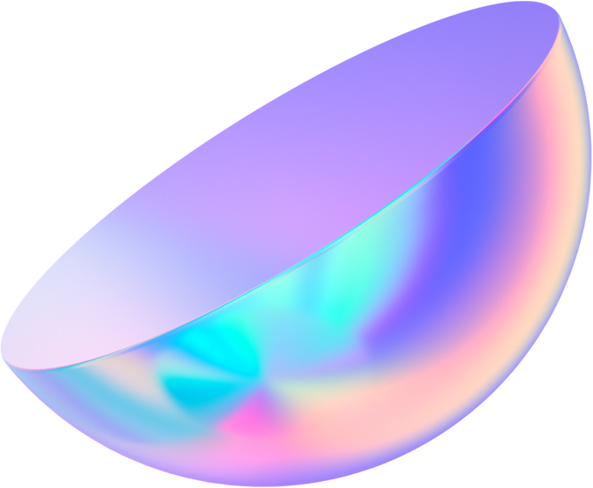
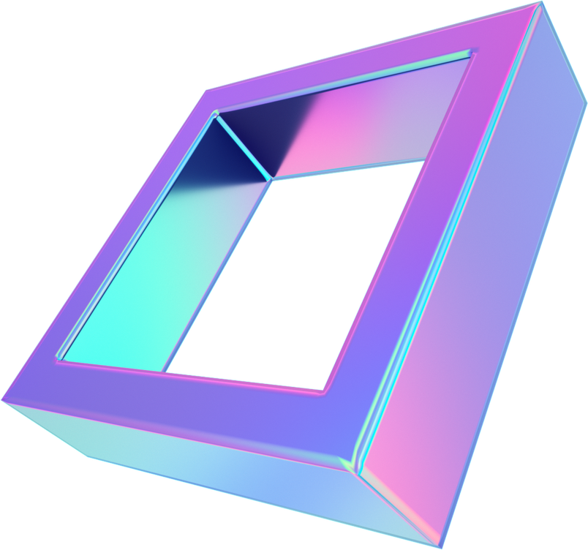
TECHNOLOGY
STACK
Natural Language Processing (NLP)
Neural Networks
HTML
CSS
JAVASCRIPT

Slide 3

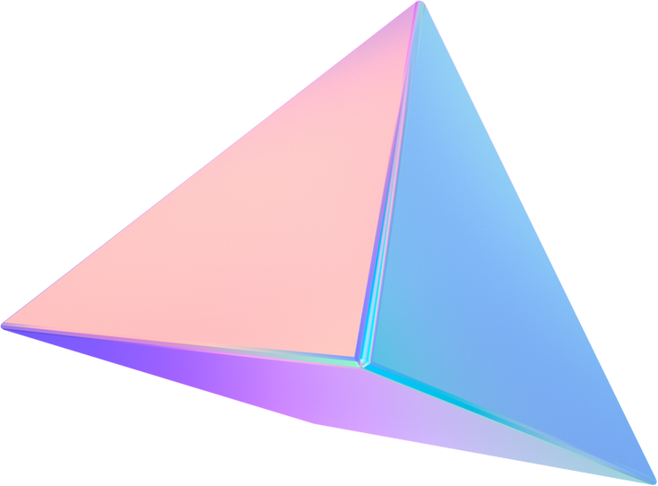
INTRODUCTION
Emotion detection and music recommendation have become pivotal applications in the field of artificial intelligence, aiming to enhance user experiences by providing personalized content. This chatbot leverages neural networks, specifically using the PyTorch framework, to achieve these objectives. In this paper, we present an overview of this innovative chatbot, which combines emotion detection and Spotify music recommendations through the power of deep learning.

Slide 4

ABSTRACT
In today's digital age, technology has revolutionized how we interact with content. Emotion detection and personalized music recommendations have emerged as essential elements in enhancing user engagement and satisfaction. This chatbot integrates these two functionalities using neural networks implemented in PyTorch. Through natural language processing, the chatbot detects user emotions and tailors Spotify music recommendations accordingly.
The architecture of this chatbot is built upon a deep learning framework, enabling it to analyze text inputs for emotional cues and then provide music recommendations that resonate with the user's current emotional state. This innovative approach harnesses the power of neural networks to create a seamless and personalized user experience.
Our study highlights the development process, technical aspects, and the potential impact of this chatbot in enhancing user engagement and satisfaction. By fusing emotion detection with music recommendation, we address the evolving needs of users in a dynamic digital landscape. The chatbot's integration of PyTorch's capabilities showcases the robustness of deep learning techniques in real-world applications.

Slide 5
CONCLUSION
The chatbot discussed in this paper represents an exciting intersection of emotion detection and personalized music recommendations, offering a solution that can significantly improve user experiences in various digital platforms. By utilizing neural networks and the PyTorch framework, we have demonstrated the potential of deep learning to create innovative and user-centric applications.
The ability to understand user emotions through natural language processing and then curate Spotify recommendations accordingly has the potential to revolutionize how users engage with music streaming services. It enhances not only user satisfaction but also the overall quality of content delivery.

Slide 6
THANK YOU

